Slide 1
Intro to Transformational Theory

Slide 2
What is Transformational Theory?
a branch of systematic music theory that seeks to model relational and dynamic aspects of musical experience

Slide 3
intervallic vs. transformational
the relationship between two musical objects vs. recreate a given relationship
Musical entities are members of sets
intervals or transformations members of groups or semigroups

Slide 4
intervallic structures
modeled via Generalized Interval Systems, or GISes
set of elements
group of intervals
mapping function

Slide 5
transformational relationships
modeled via transformational networks
nodes occupied by musical entities from a set
arrows represent transformations drawn from semigroup
all GIS can be represented as a transformational network, but not all of the latter or GIS

Slide 6
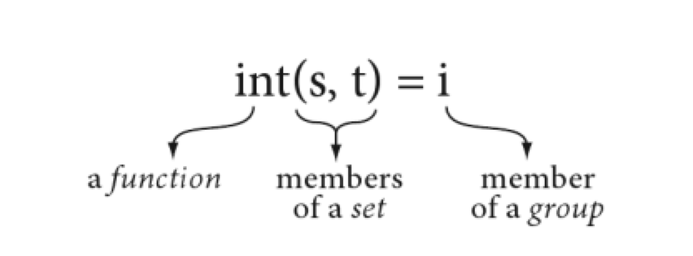
GISes
set that contains s = space of GIS (S)
S and t an ordered pair that measures directed intervals: from s to t

Slide 7
GISes
i is a member of a group: IVLS
A group = a set plus a rule that states how any 2 elements in the set may yield a third element
Binary composition

Slide 8
Group properties
Closure
the composition of any 2 elements in the set always yields another element in the set
identity element e
the composition of any other element g with e yields g
inversivity
for every element g in the set there exists an element g^{–1} such that g + g^{–1} = e
associativity
for every 3 elements f, g, h, (f • g)• h = f • (g • h)

Slide 9
Assumptions
No implication of direction or distance; an abstract measurement
intervals needn’t be all about distance, but can measure other relations
Groups may contain subgroups that articulate structure in various ways
Groups may be commutative or noncommutative
If groups are isomorphic, they have the same abstract structure
a GIS inherits the structural characteristics of its IVLS

Slide 10
S and IVLS
int a mapping from set X to set Y that sends each element x in X to some element y in Y: f(x)=y
x=argument, y=image or value of x under f
X=domain, Y = range

Slide 11
S and IVLS
domain of int = set of all ordered pairs of elements from S (s,t)
f(x) = int(s,t)
the set of all (s,t) = S cross S or the Cartesian product of S with itself
int maps S x S into IVLS

Slide 12
A diatonic example
int (C4,D4) = +1
int (D4,C4) = -1
S here = diatonic “white-note” pitches.
IVLS = integers under addition
int sends ordered pairs of diatonic pitches to some element in the group of integers
This examples illustrates simple transitivity
In any GIS there will be as many elements in S as there are intervals in IVLS

Slide 13
GIS and Cartesian Dualism
f(x) = y is also x–^{f}– y
f takes x to y
(s,t)x–^{int}– i
a passive calculation of relationships as points in space
musical perceiver is subject, music is object

Slide 14
Intervallic Apperceptions
intuitions are culturally conditioned
they may be changed or expanded through analytical reflection
Rings calls this apperceptions because they are perceptions influenced by past experience and present reflection
That is, as you go through an analysis, you might change how you perceive relationships by grouping data differently, etc.

Slide 15
Formal Limitations of GISes
A given musical space must have a limit
Any interval must be applicable at all point in the space
So modular spaces work, but not all non-modular spaces
intervals in a GIS are defined by the relationship the analyst construes between its endpoints

Slide 16
Bach, Cello Suite in G, BWV 1007, Prelude, mm. 1–4
3 different intervallic conceptions of i:
ascending 10th in G major diatonic pitch gamut
IVLS = integers under addition (ℤ, +)
int(G2,B3) = +9
privileges interval over harmony

Slide 17
Bach, Cello Suite in G, BWV 1007, Prelude, mm. 1–4
3 different intervallic conceptions of i:
depicts G major arpeggio
S = elements of G major triad, where G2 is next to B2
int(G2,B3) = +4
relevant to the historical context, the style brisé

Slide 18
Bach, Cello Suite in G, BWV 1007, Prelude, mm. 1–4
3 different intervallic conceptions of i:
harmonic space of just intervals in which i = 5:2
G2–D3–B3 = partials in the G overtone series
IVLS = positive rational numbers under multiplication
int(G2,D3) = 3:2; int(D3,B3) = 5:3
a just perfect fifth followed by a just major sixth

Slide 19
Bach, Cello Suite in G, BWV 1007, Prelude, mm. 1–4
3 different intervallic conceptions of i:
f) G3 arrives in m. 4
D3 to G3 manifests the scaler space from (b)
and fills the gap
e) k represents a skip in the overtone series above G1
G3 (partial 4) is missing

Slide 20
Transformations and Operations
A function from S to S itself
transformations and operations in a transformational graph or network = functions that act directly on single musical entities.

Slide 21
The transformation ResC on S sends every element in S to the element C.
Step moves each element in S up one diatonic step.
Both transformations map the note B to C.
ResC suggests a gravitational centering on C, while Step suggests a more neutral, uniform motion of single-step ascent anywhere in the space.
Step is an operation: one-to-one and onto
ResC has no inverse function: it is a transformation, but not an operation

Slide 22
Transformations and operation can combine through composition of mappings. Here Step followed by Step yields Step².
Sets of transformations and operations can be combined to yield groups, or semigroups, in which the composition of mappings is the binary composition
The result is a group of operations Transformations that aren’t operations can’t combine into groups, only semigroups: those that satisfy closure and associativity, but not identity and inverse

Slide 23
Transformations and Operations
The structure = “semigroup action on a set” of musical elements, representatives of which occupy the nodes of a transformational network.
The semigroup of transformations “acts” on this set, modeling behaviors performed directly on entities in S.
Unlike the GIS perspective, a transformational arrow models the active performance of some musical gesture that transforms one musical element into another.
Semigroup (or group) elements act directly on the musical entities themselves.

Slide 24
Between GIS and Transformational Networks
Any GIS can be made into a transformational statement and vv.
But a transformation can’t be made into a GIS unless it represents an operation
That group of operations must act on elements in S in a simply transitive way.
Given any two a and b in the set, only one element g takes a to b.
Think about the relation between T and I!

Slide 25
Schubert, Piano Sonata, D. 664, mvt. ii, mm. 1–7
3-note gestures

Slide 26
Schubert, Piano Sonata, D. 664, mvt. ii, mm. 1–7
3-note gestures
X main motive, Y related to X
X’ changes the intervals of X
T(Y) is a transposition
Two cadential gestures
x a “recollection” of X
S = diatonic pitches in D
transformations = steps up and down
X goes from B4 to F# (-3)
X’ goes from B4 to E4 (-4)
Both X and X’ begin with B4⁻¹ A4
-1 and -3 are also in X’, but -3 is now internal
-1 is everywhere

Slide 27
Schubert, Piano Sonata, D. 664, mvt. ii, mm. 1–7
X
X’
-1
-1
B4
B4
A4
A4
-3
-2
-4
-3
E4
F#4
-1
Influence of -1 on a larger scale

Slide 28
Y
T(Y)
+
D5
+2
A4
B4
+2
-1
+
+
+3
A4
+3
+
F#4
-1
E4
-3
Y forms
-1 links X and X’ = appoggiaturas in X and Y
the remaining arrows reverse the gestures in X
-3 takes Y to T(Y), while -3 in X connects B4 and F#4

Slide 29
Schubert, Piano Sonata, D. 664, mvt. ii, mm. 1–7
Cad
G4
-1
+3
F#4
D4
+2
Same 3 transformations as Y in a different order
-1 ends the cadence, the reversal heightened by x
Cad is a retrograde inversion of Y and T(Y) about F#4
Cad is the first gesture to begin with an ascent,
and doesn’t relate to X

Slide 30
Schubert, Piano Sonata, D. 664, mvt. ii, mm. 1–7
BassCad
D3
+3
+2
B2
A2
+1
For the first time +1 appears, as A/B reverses
Cad has an inversional relationship with Y,
BassCad has an inversional relationship with X

Slide 31
X Duration
proportional
additive
(-1, + )
(-1, 2)
A4
B4
B4
(-2, + )
A4
(-2, 1¹/2)
(-3,3)
F#4
(-3, )
F#4
transformational labels ordered pairs,
offering two different perspectives on duration
Two different group structures:
integers under addition vs. nonzero rational numbers under multiplication
Ordered pairs (pitch, duration)

Slide 32
Y Duration
proportional
additive
D5
(+2, ¹/2)
(-2, - )
D5
B4
(+3, ¹/3)
B4
A4
(+3,- )
A4
(-1, 1¹/2)
(-1, + )
Descending pitch motions increase in duration while
ascending pitch motions decrease
Correspondances between pitch and rhythm
Y forms “float,” while X forms “sink”

Slide 33
The proportional relation between X and Y
3
2
1¹/2
X:
Y:
=
1
³/4
¹/6
¹/2
1¹/2
¹/3
=
¹/2

Slide 34
Bass Cad inverts X in pitch space, and in additive duration space as well as operating as a syntactic inverse (ending rather than beginning)
BassCad
D3
(+3, - )
(+2, - )
B2
A2
(+1,- )
Bass Cad thus inverts X as a complete pitch/time gesture

Slide 35
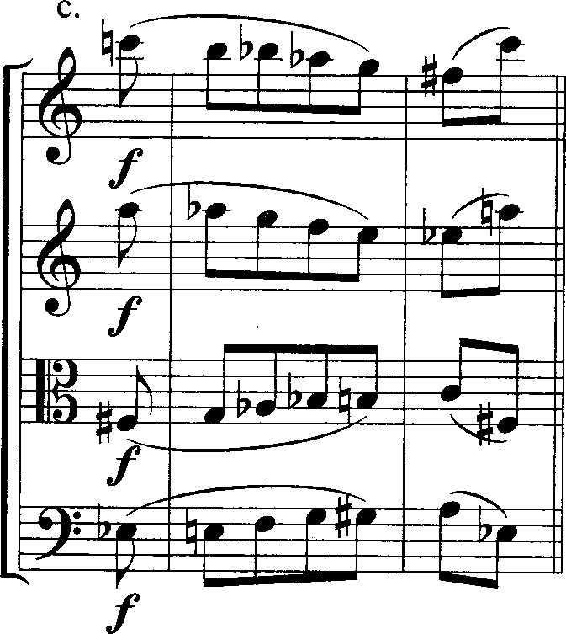
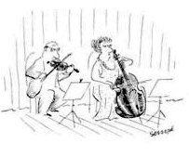
C---B---Bb-Ab-G---F#--C A---Ab-G---F---E---Eb--A F#-G---Ab-Bb-B---C----F# Eb-E---F---G---G#-A---Eb
regular inversion:
[0369] at I0
[0369] at I^{C} F#

Slide 36
Eb-D-Db-C-B-Bb-A Eb-F-F#-G-Ab-A

Slide 37
contextual inversion:
Recursive retrograde inversion relations in the theme of
György Ligeti’s Metamorphoses Nocturnes

